Slide 1
MobileNet
Vignesh R

Slide 2
Motivation for MobileNet
Low computational cost at deployment
Useful for mobile and embedded vision applications
Three Versions
MobileNetV1 [2017] - MobileNets: Efficient Convolutional Neural Networks for Mobile Vision Applications
MobileNetV2 [2019] - MobileNetV2: Inverted Residuals and Linear Bottlenecks
MobileNetV3 [ 2019] – Searching for MobileNetV3
Key Idea
DepthWise Seperable Convolutions
  Depthwise Convolutions
  Pointwise Convolutions
Width Multiplier
Resolution Multiplier

Slide 3
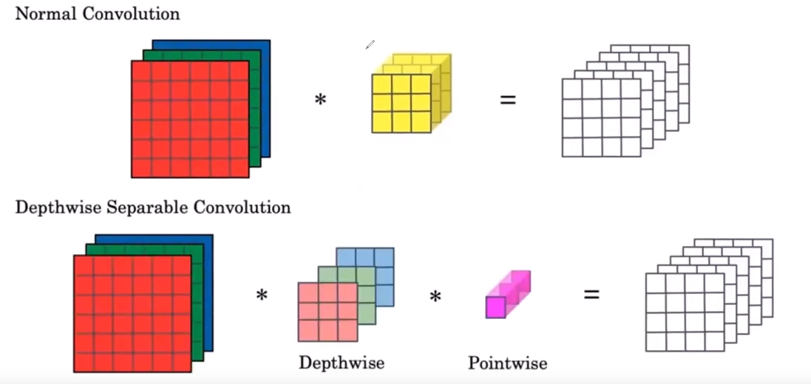
Normal VS Depthwise Seperable Conv
>

Slide 4
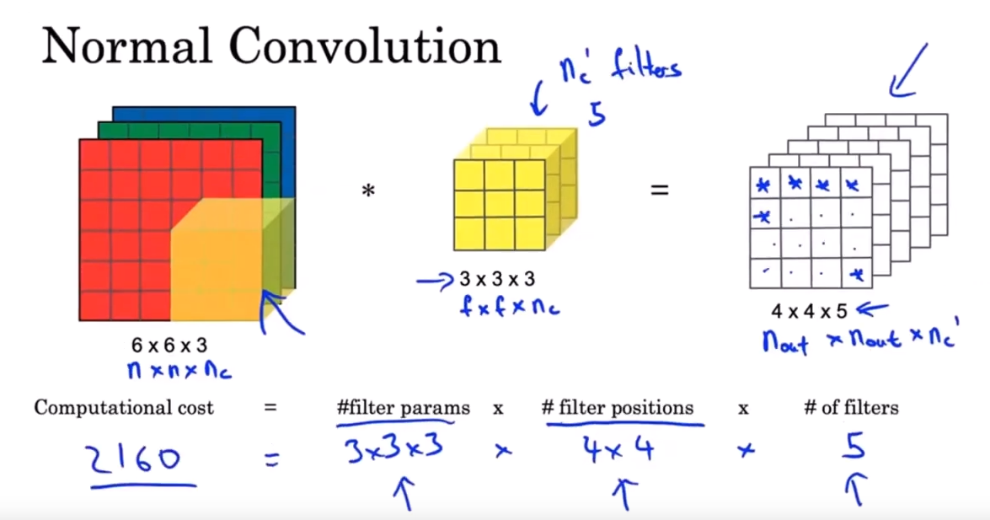
Normal Convolution
Normal Convolution – Convolution performed on all channels

Slide 5
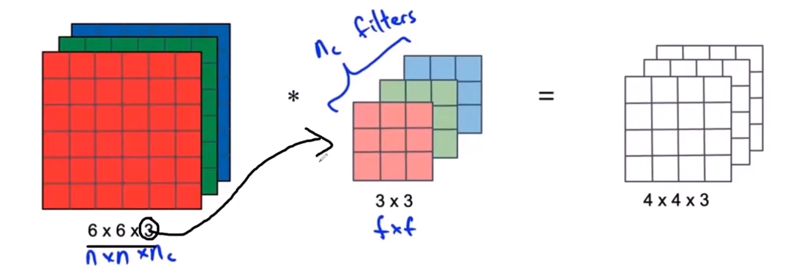
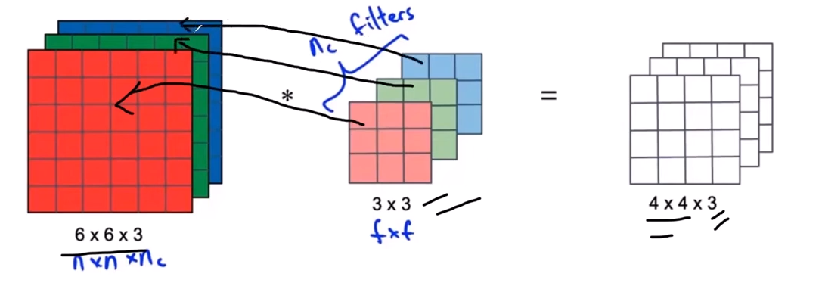
Depthwise Convolution
> Depthwise convolution – convolution performed on seperate channels

Slide 6
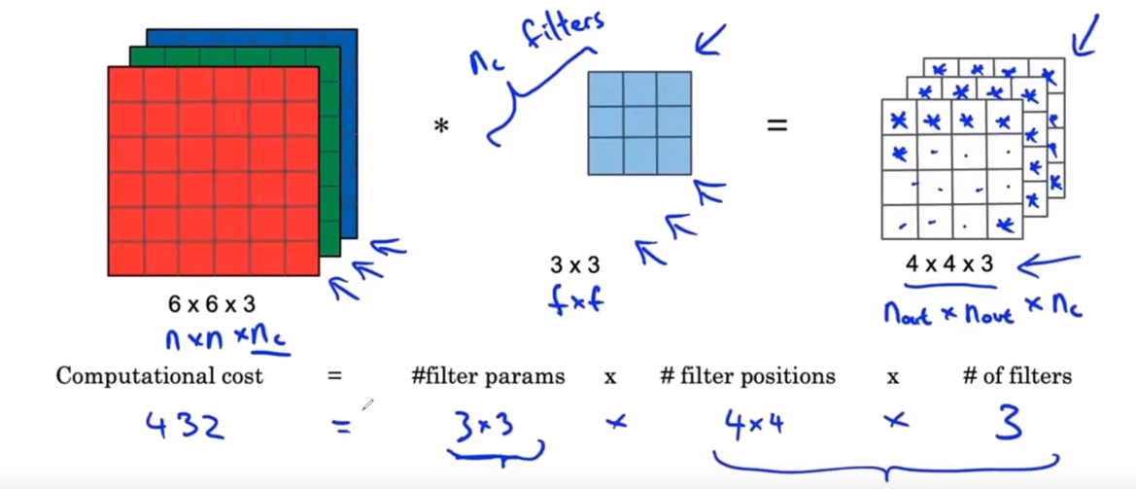
Depthwise Convolution
>

Slide 7
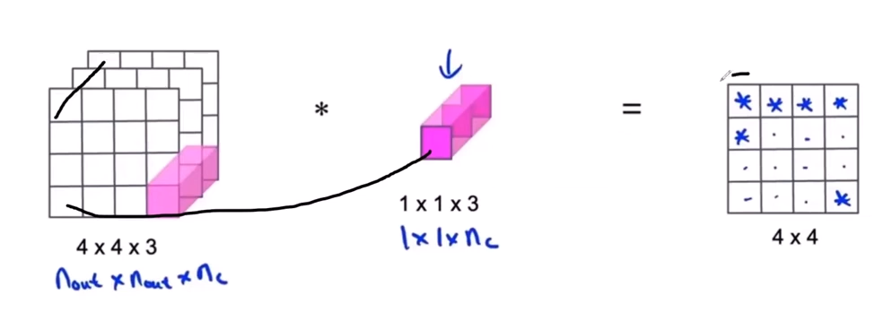
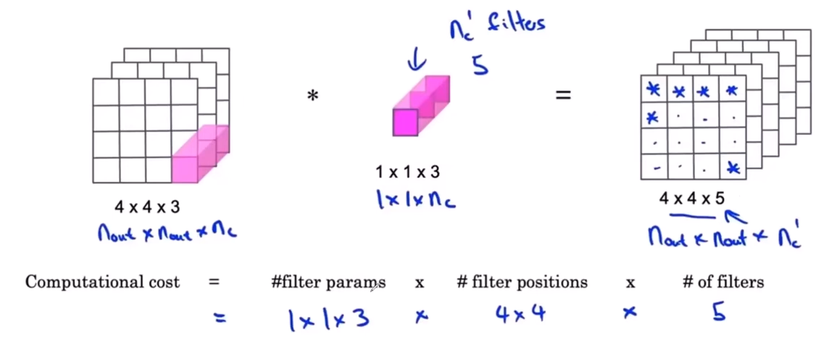
PointWise Convolution
> Pointwise convolution – 1x1 convolution to modify channels

Slide 8
Hyperparameters
Width Multiplier - adjusts the number of channels
The width multiplier (denoted by α) is a global hyperparameter that is used to construct smaller and less computationally expensive models. Its value lies between 0 and 1.
For a given layer and value of α, the number of input channels 'M' becomes α * M and the number of output channels 'N' becomes α * N hence reducing the cost of computation and size of the model at the cost of performance.
The computation cost and the number of parameters decrease roughly by a factor of α2. Some commonly used values of α are 1,0.75,0.5,0.25.
Resolution Multiplier - adjusts the spatial dimensions of the feature maps and the input image
The second parameter introduced in MobileNets is called the resolution multiplier and is denoted by ρ.
This hyperparameter is used to decrease the resolution of the input image and this subsequently reduces the input to every layer by the same factor.
For a given value of ρ, the resolution of the input image becomes 224 * ρ. This reduces the computational cost by a factor of ρ2.

Slide 9
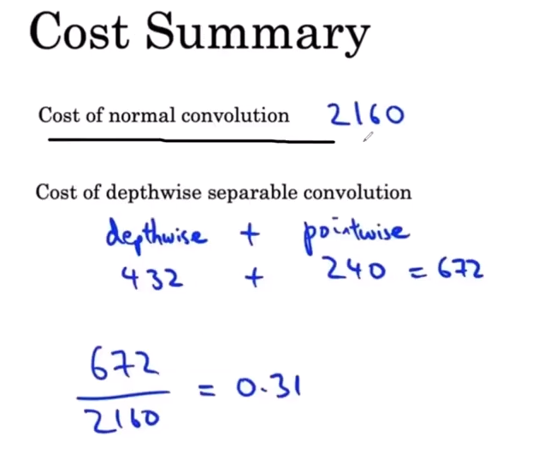
Normal VS Depthwise Seperable Conv
>

Slide 10
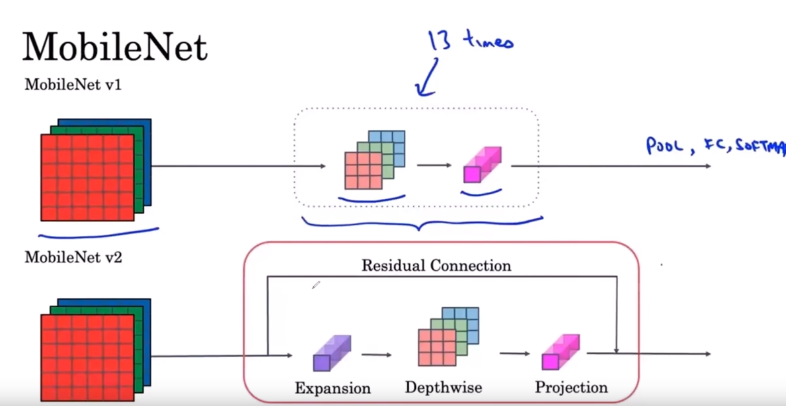
MobileNet versions
>

Slide 11
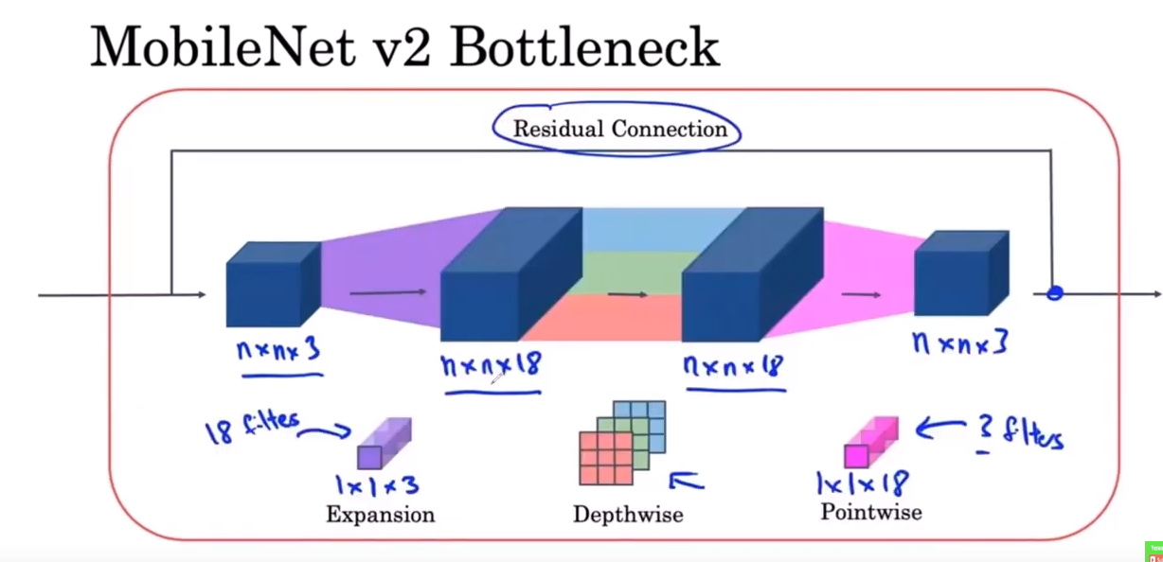
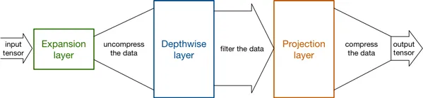
MobileNet V2 bottleneck
>

Slide 12
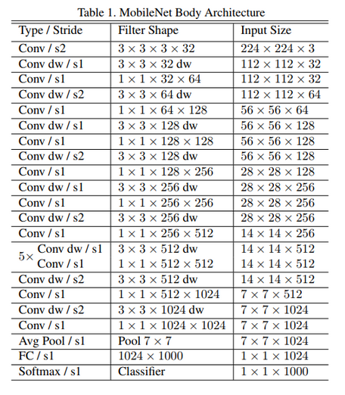
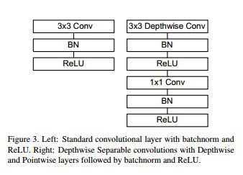
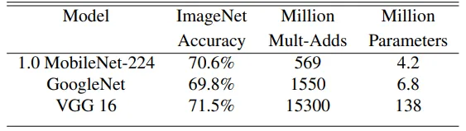
MobileNet V1 architecture
>

Slide 13
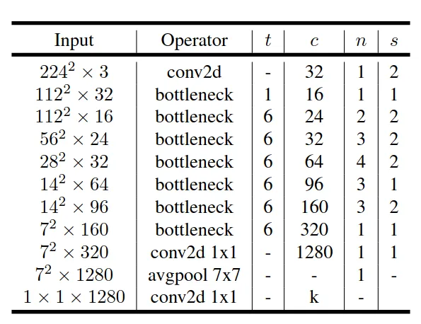
MobileNetV2 architecture
>

Slide 14
References:
MobileNets: Efficient Convolutional Neural Networks for Mobile Vision Applications
MobileNetV2: Inverted Residuals and Linear Bottlenecks
Mobilnet explained- Youtube
Network in Network convolutions
Understanding Depthwise Separable Convolutions and the efficiency of MobileNets
An Overview on MobileNet: An Efficient Mobile Vision CNN
Mobilenet Implementation
MobilenetV1 Pytorch Implementation

